Slide 1

MIT Climate Grand Challenges – Accelerating Innovation to Address the Climate Crisis
David M. Babson, PhD⎟ Executive Director
MIT Climate Grand Challenges
MIT Energy & Climate Hackathon
November 8, 2023

Slide 2
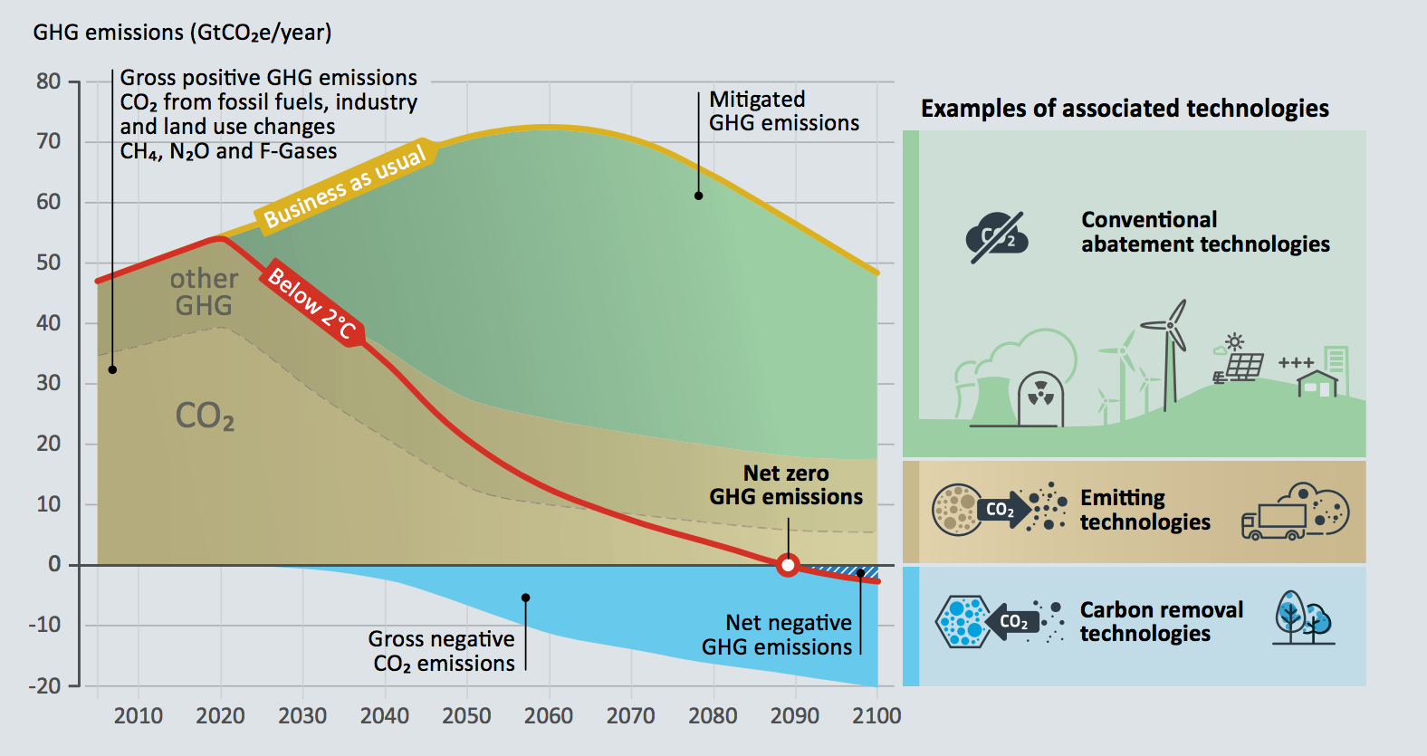
Because of inaction, all paths to 2°C now go through zero
National Academy of Sciences. Negative Emissions Technologies and Reliable Sequestration: A Research Agenda. 2019. p. 3

Slide 3
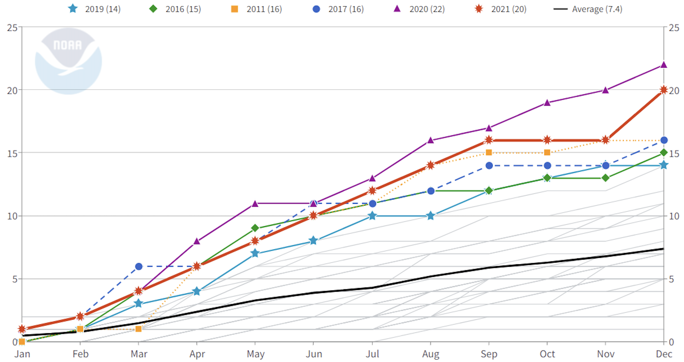
Climate change is no longer an abstract, future problem
United States Billion-Dollar Disaster Event Count (CPI Adjusted, 1980-2021)
2019
(14)
2016
(15)
2011
(16)
2017
(16)
2020
(22)
2021
(20)
Average (7.4)
Number of Events
Number of Events

Slide 4
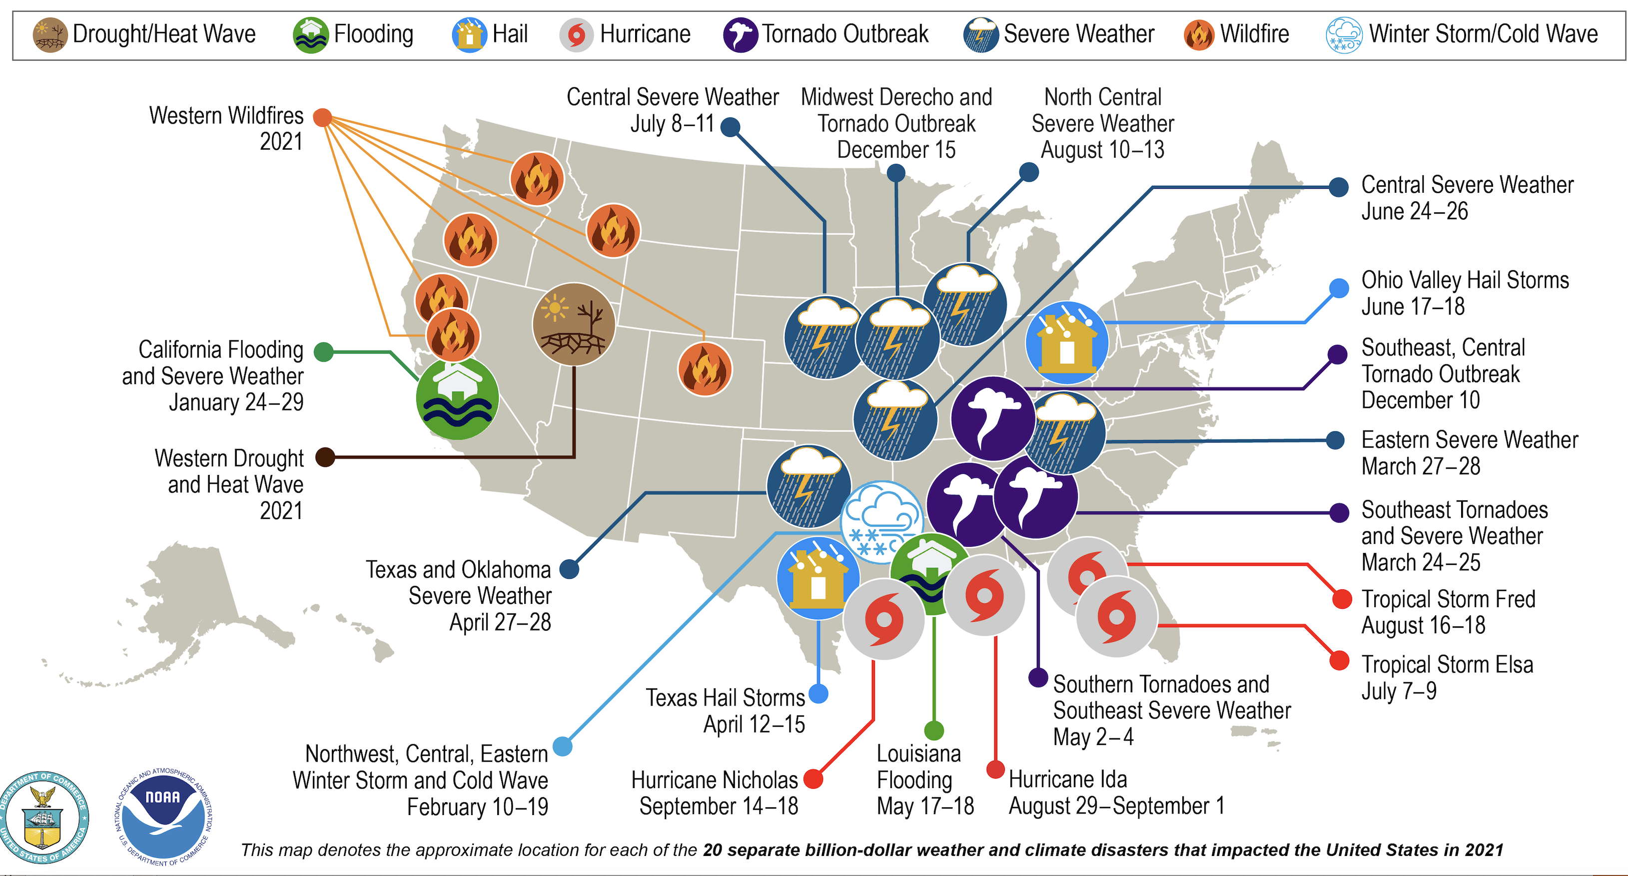


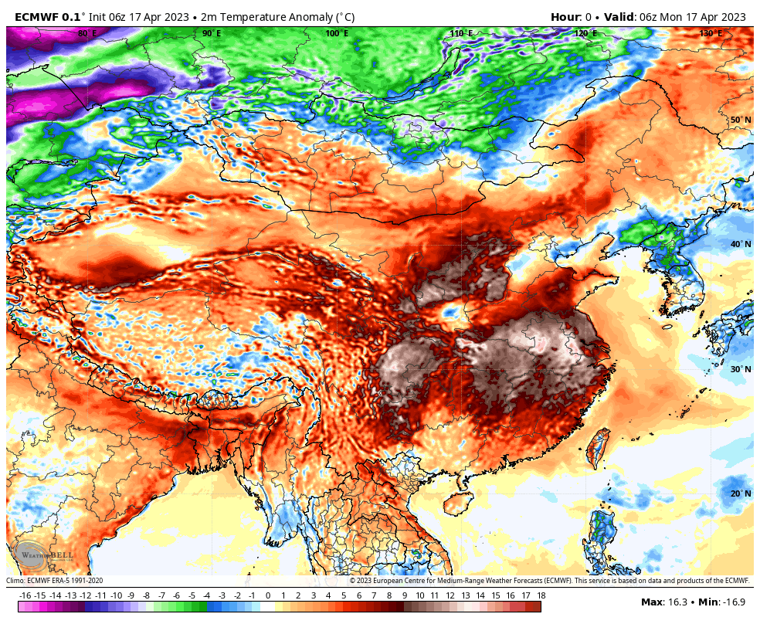
Climate change is no longer an abstract, future problem
United States 2021 Billion-Dollar Weather and Climate Disasters
And it is global……
Derna, Libya
… September 2023
Maui, HI
…August 2023
Southeast Asia
…last year
Notes:
So addressing the human causes of climate change are enormous challenges, the results of past emissions are being felt now and have to be dealt with simultaneously, and we have some other issues to consider too…..

Slide 5
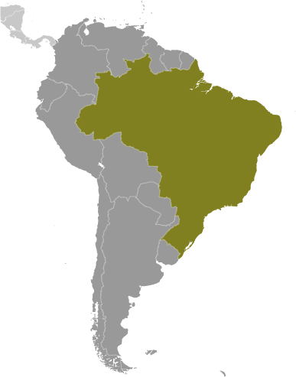
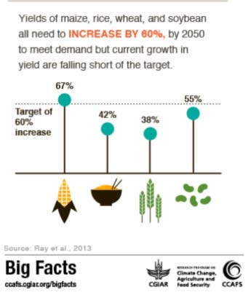
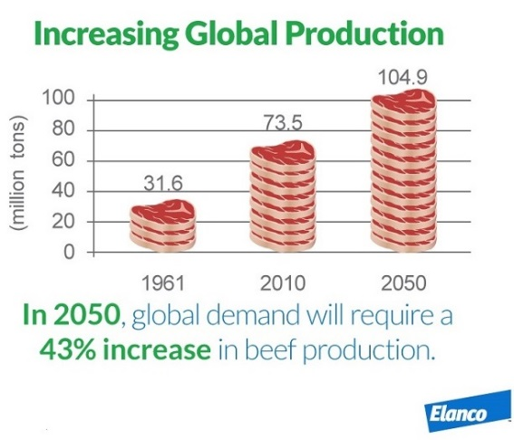
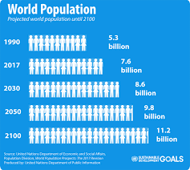
Beyond climate and carbon – Food Security
Population
Affluence
Land
An estimated 10⁹ ha of new land will be required to feed global population in 2050

Slide 6
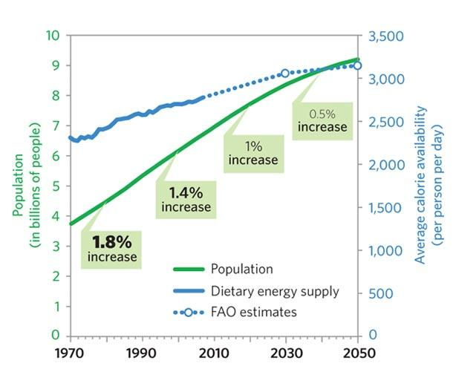
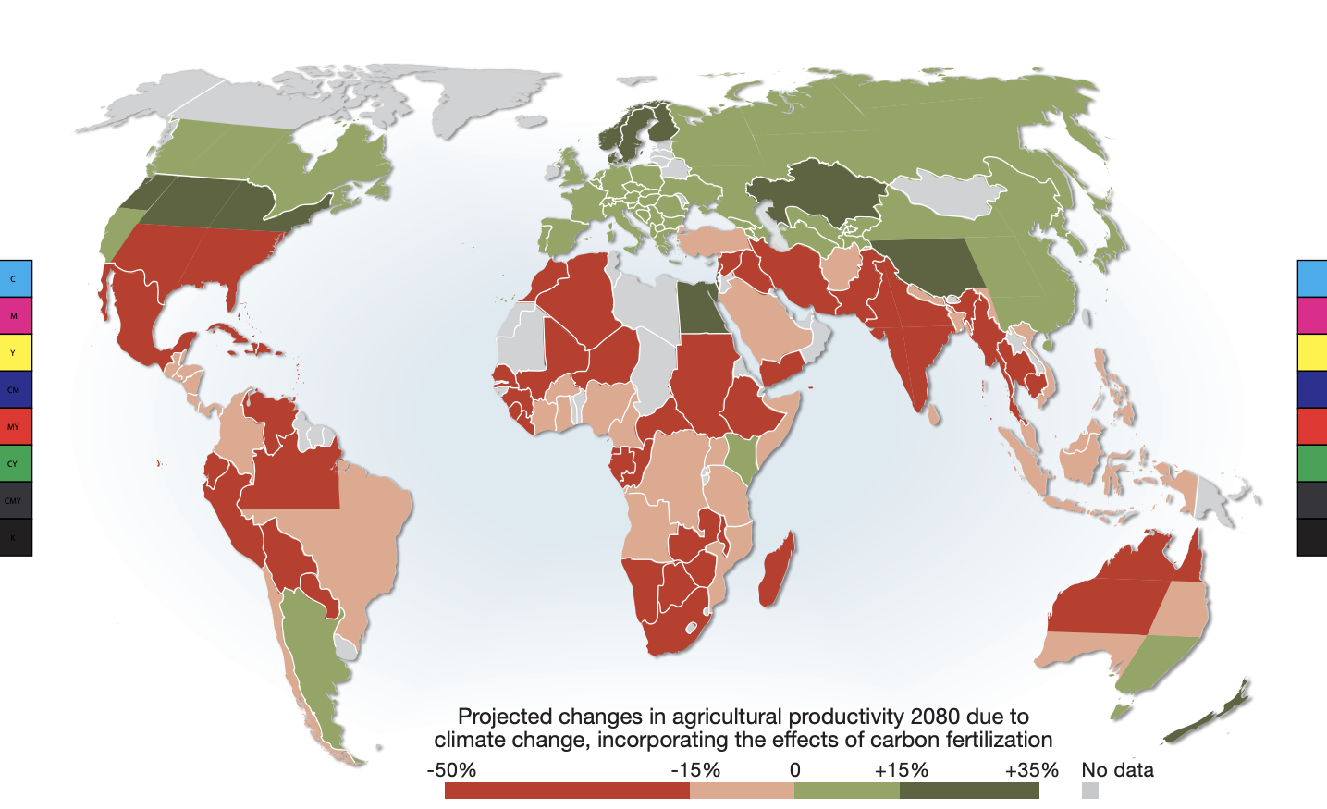
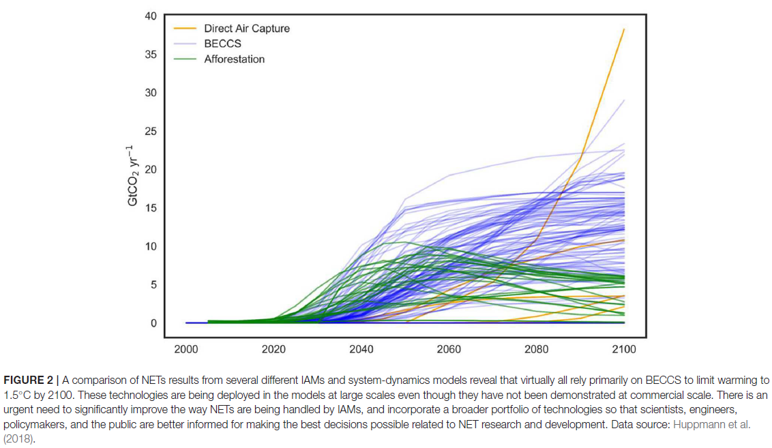
Beyond climate and carbon – Food Security
Innovation needed – Anticipated productivity gap
Climate change and its solutions increase land demands
Reduced Yield
Food and Agriculture Organization (FAO) estimates
Notes:
Population, affluence, land

Slide 7
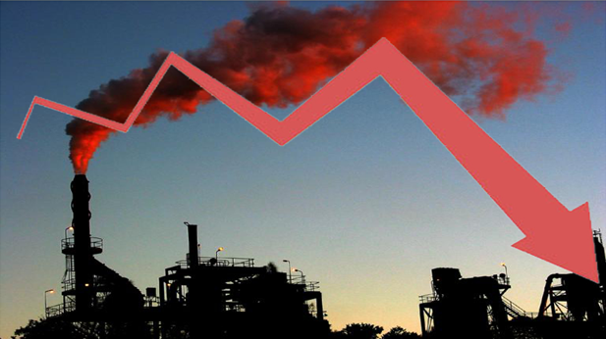

Drivers for innovation – Get to carbon and land-use negative
Carbon / GHG Emissions Reductions
Land Sparing
Carbon / GHG Emissions
Our global economy needs to be structured in a way that incentivizes not only land and carbon ‘neutrality’, but promotes becoming both carbon and land negative, perhaps by leveraging a future clean energy grid.

Slide 8
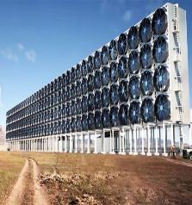


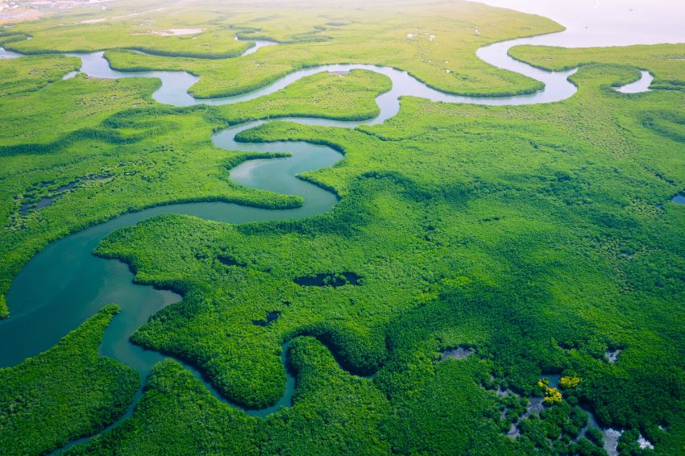


Transformative innovations are needed – and quickly
Reducing carbon emissions
Enabling negative emissions pathways
Addressing resource needs
Protecting and restoring critical ecosystems
Designing for and aligning infrastructure with a future carbon negative economy
Promoting sustainability / circularity

Slide 9
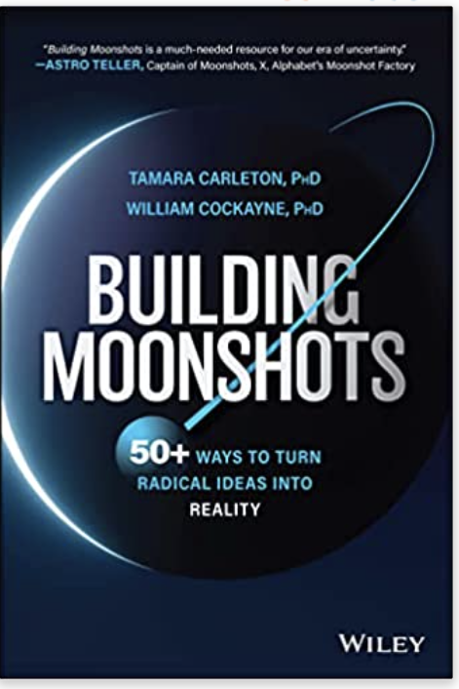



Transformative innovations are needed – and quickly
A model that aims high and accelerates innovation for impact is necessary for addressing the climate crisis
Following a model for accelerating innovation to achieve defined transformative aims

Slide 10
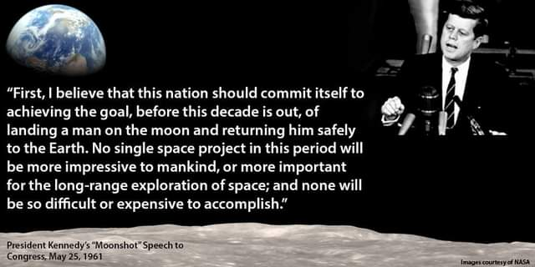
The moonshot

Slide 12


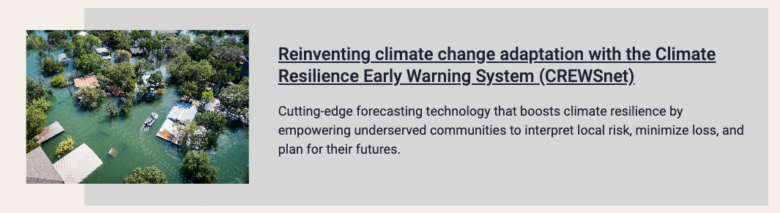
5 Flagships – Critical computational needs
Bringing computation to the climate challenge
- BC3 -
Preparing for a new world of weather and climate extremes
- Extremes -
Reinventing climate change adaptation with the Climate Resilience Early Warning System
- CREWSnet -
Notes:
Connecting earth science, climate modeling, machine learning, and AI to improve global climate predictive capacities and systematically reduce decision making risk.

Slide 13
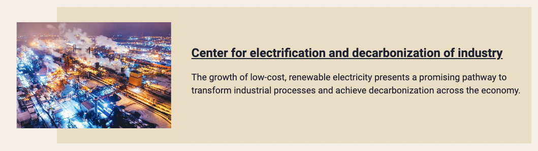
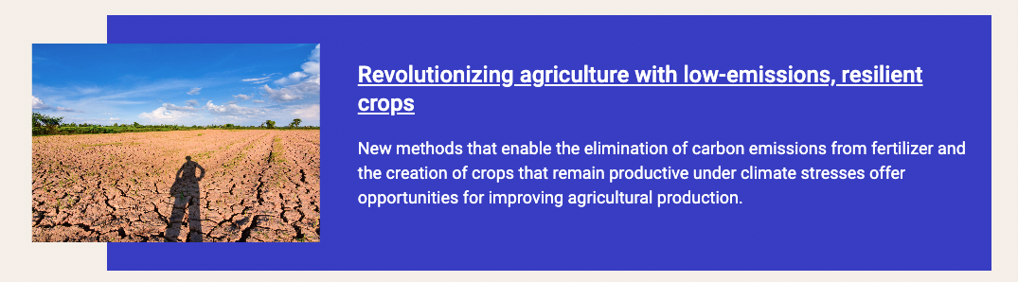
5 Flagships – Decarbonizing critical economic sectors
Center for electrification and decarbonization of industry
- CEDI -
Revolutionizing agriculture with low-emissions, resilient crops

Slide 14

MIT Climate Grand Challenges
Moonshot Targets
Accelerating innovation for a sustainable planet and prosperous society.
Mission
To empower and scale a community of innovators by operating a replicable
innovation acceleration process….
…that drives impactful results to alter the current
climate trajectory.
Aggressive metrics and active project management for accelerating solutions for the climate crisis

Slide 15
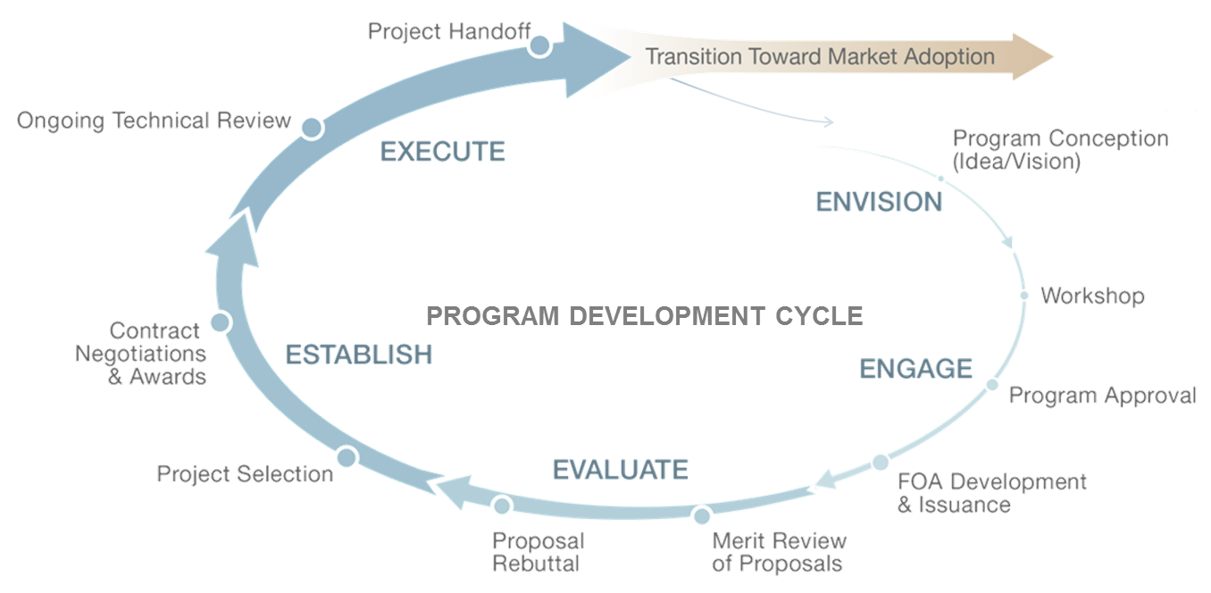
A novel Innovation Acceleration Model for top-down Grand Challenges
Project Handoff
Ongoing Technical Review
Challenge Conception
(Idea/Vision)
CHALLENGE DEVELOPMENT CYCLE
Workshop
Contract Negotiations & Awards
Challenge Pitch & Approval
Project Selection
RFP Development & Issuance
Proposal
Refinement
Merit Review of Proposals

Slide 16
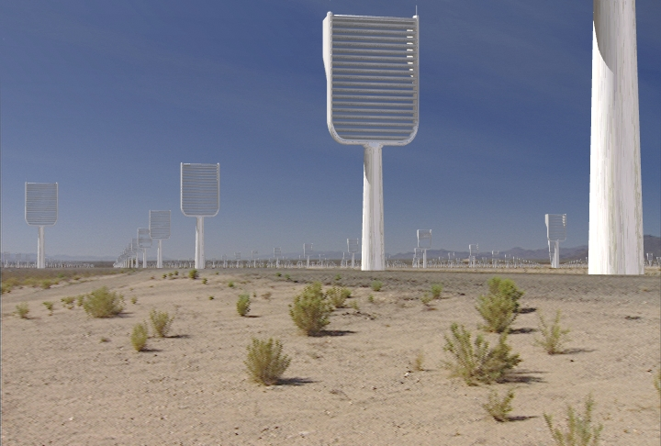
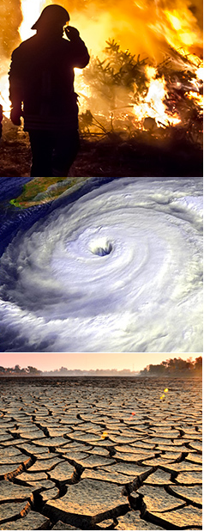
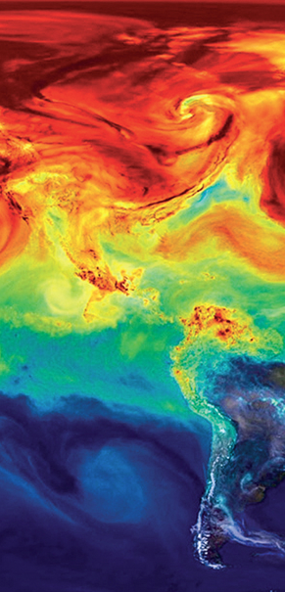

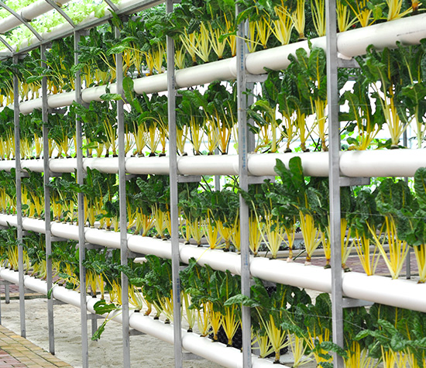
Solution spaces and outcomes
Sustainable food and agriculture
Low-cost carbon dioxide removal
Resiliency to climate impacts
Improving climate predictions to reduce risk
Sustainable fuels and chemicals

Slide 17
Thanks for having me!
David M. Babson, Ph.D.
Executive Director | Climate Grand Challenges
Massachusetts Institute of Technology
o. (617) 258-0608 | dbabson@mit.edu

Slide 18

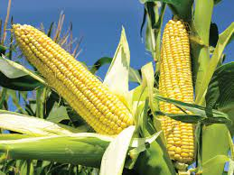
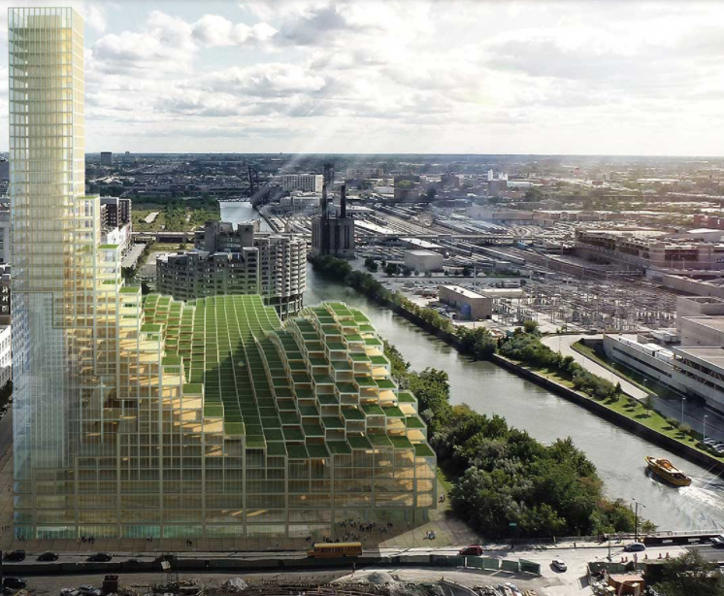
Paradigm shift
Traditional Agriculture
Zero-land Agriculture
Vertical Agriculture &
Engineered Urban Ecosystems

Slide 19
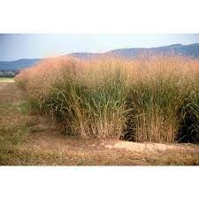
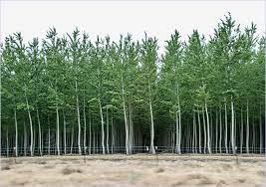
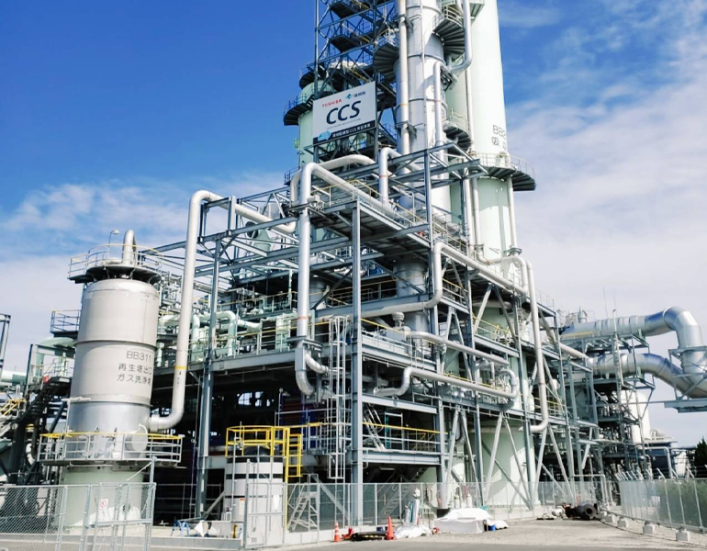
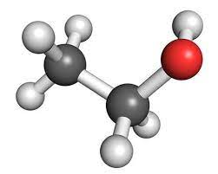
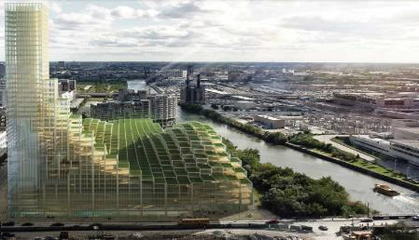

Paradigm shift
Bioenergy Bioeconomy
Drawdown Bioeconomy
A bioeconomy that optimizes for energy product recovery and offers carbon reductions by displacing petroleum
A bioeconomy that optimizes for carbon drawdown and offers energy reductions by displacing DAC

Slide 20
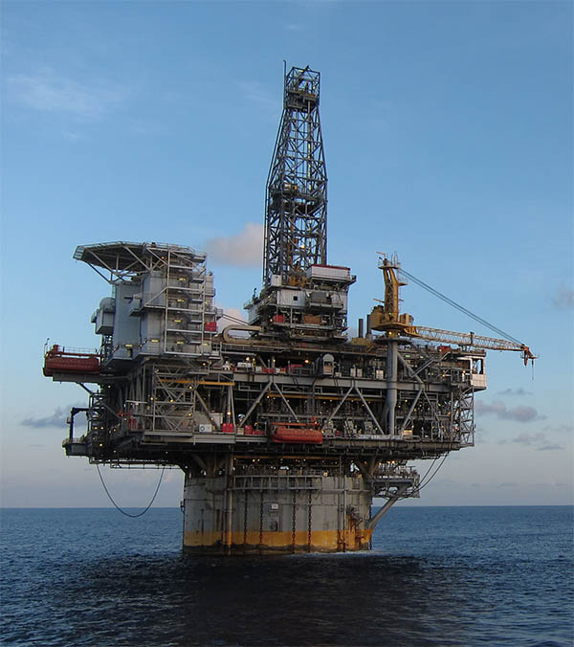
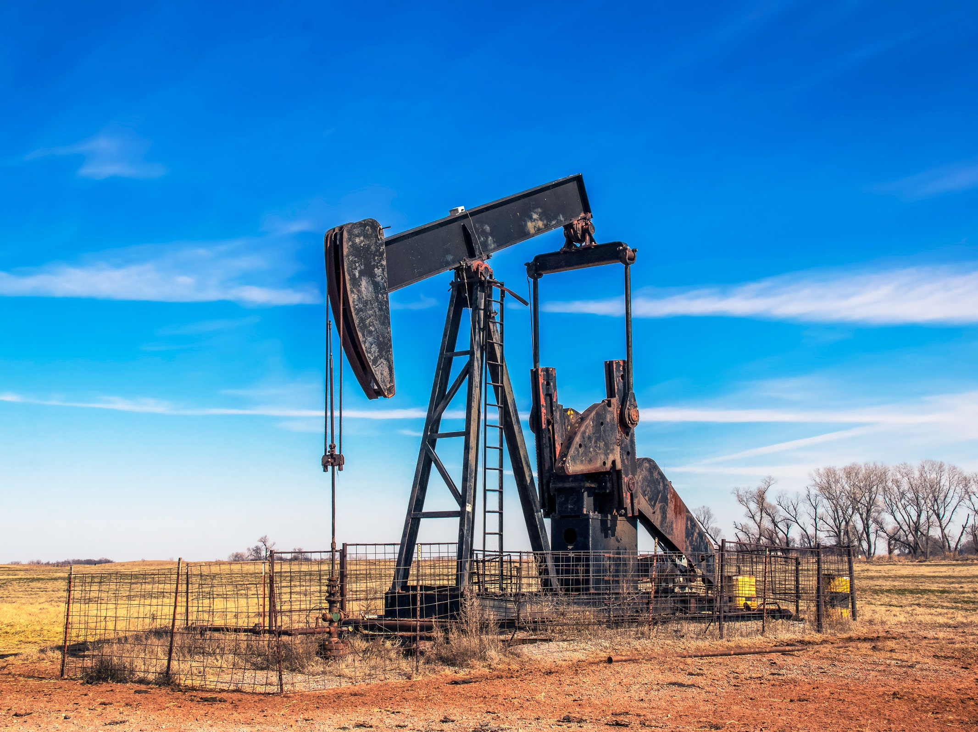
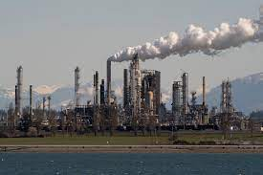
Paradigm shift
Petroleum fuels
Fuels from air

Slide 21
And challenges cannot be limited to technical innovation
New ancillary ideas to support tech and solutions deployment
Business Models, Financial Structures, and Policy Frameworks
Negative emissions pathways
Maintaining and restoring ocean currents and vital ecosystems
Reimagining land use for carbon management and ecosystem services
Notes:
Future business leaders:
Beyond carbon, putting a price on ecosystem services, non-ag/undeveloped land, and other environmental attributes
How to value products in this new economy
How to think differently about risk, finance, social license for businesses

